Slide 1
COMP6115 Object Oriented Analysis and Design Session #8

Slide 2
Class and Method Design

Slide 3
Learning Outcomes
LO1: Identify the basic concept of advance topic in
Object Oriented Analysis and Design
LO2 : Use the knowledge to develop documentation
for object oriented software analysis and
design using Unified Modelling Language
LO3 : Analyze any problem in any software
application and find out the alternative
solutions using object oriented analysis and
design approach

Slide 4
Chapter 8: Class and Method Design

Slide 5
Objectives
Become familiar with coupling, cohesion, and connascence.
Be able to specify, restructure, and optimize object designs.
Be able to identify the reuse of predefined classes, libraries, frameworks, and components.
Be able to specify constraints and contracts.
Be able to create a method specification.

Slide 6
Introduction
Review the characteristics of object orientation
Present useful criteria for evaluating a design
Present design activities for classes and methods
Present the concept of constraints & contracts to define object collaboration
Discuss how to specify methods to augment method design
Caution:
Class & method design must precede coding
While classes are specified in some detail, jumping into coding without first designing them may be disastrous

Slide 7
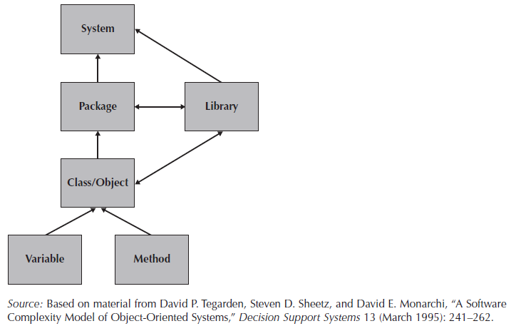
Levels of Abstraction in Object-Oriented Systems

Slide 8
Core packages in Java SE 8
java.lang — basic language functionality and fundamental types
java.util — collection data structure classes
java.io — file operations
java.math — multiprecision arithmetics
java.nio — the Non-blocking I/O framework for Java
java.net — networking operations, sockets, DNS lookups, ...
java.security — key generation, encryption and decryption
java.sql — Java Database Connectivity (JDBC) to access databases
java.awt — basic hierarchy of packages for native GUI components
java.text — Provides classes and interfaces for handling text, dates, numbers, and messages in a manner independent of natural languages.
java.rmi — Provides the RMI package.
java.time — The main API for dates, times, instants, and durations.
java.beans — The java.beans package contains classes and interfaces related to JavaBeans components.
java.applet — This package provides classes and methods to create and communicate with the applets.

Slide 9
Characteristics of OOSAD
Classes
Instantiated classes are objects
Classes are defined with attributes, states & methods
Classes communicate through messages
Encapsulation & information hiding
Combine data and operations into a single object
Reveal only how to make use of an object to other objects
Key to reusability
Polymorphism & dynamic binding
Inheritance

Slide 10
Polymorphism & Dynamic Binding
Polymorphism
The ability to take on several different forms
Over-riding (inheritance): Implement all methods in an interface
Function over-loading: same name, different function content
plotGraph(x,y)
plotGraph(x,y,z)
>> diff # of parameter, diff type of parameter, diff order or parameter
Templates? LinkedList in Java LL list<E>
Swap function -> define dynamic data type in the run!
Same message triggers different methods in different objects
Dynamic binding vs Static Binding
Methods—the specific method used is selected at run time
Attributes—data type is chosen at run time
Implementation of dynamic binding is language specific
Decisions made at run time may induce run-time errors
Need to ensure semantic consistency

Slide 11
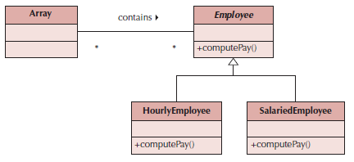
Polymorphism Example

Slide 12
Inheritance
Permits reuse of existing classes with extensions for new attributes or operations
Types
Single inheritance -- one parent class
Multiple inheritance -- multiple parent classes (not supported by all programming languages)
Redefinition of methods and/or attributes
Not supported by all programming languages
May cause inheritance conflict
Designers must know what the chosen programming language supports

Slide 13
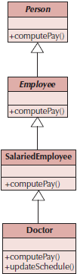
Inheritance Conflicts
An attribute or method in a sub-class with the same name as an attribute or method in the super class
Cause is poor classification of sub-classes:
Generalization semantics are violated, or
Encapsulation and information hiding principle is violated
May also occur in cases of multiple inheritance

Slide 14
Design Criteria
A set of metrics to evaluate the design
Coupling—refers to the degree of the closeness of the relationship between classes
Cohesion—refers to the degree to which attributes and methods of a class support a single object
Class Cohesion
Class Student: NIM, Name, GPA 👍
Class Student: NIM, Name, GPA, Lecturer Name 👎
Connascence—refers to the degree of interdependency between objects

Slide 15
Coupling
Close coupling means that changes in one part of the design may require changes in another part
Types
Interaction coupling measured through message passing
Inheritance coupling deals with the inheritance hierarchy of classes
Minimize interaction coupling by restricting messages (Law of Demeter)
Minimize inheritance coupling by using inheritance to support only generalization/specialization and the principle of substitutability

Slide 16
Law of Demeter
Messages should be sent only by an object:
to itself
to objects contained in attributes of itself or a superclass
to an object that is passed as a parameter to the method
to an object that is created by the method
to an object that is stored in a global variable

Slide 17
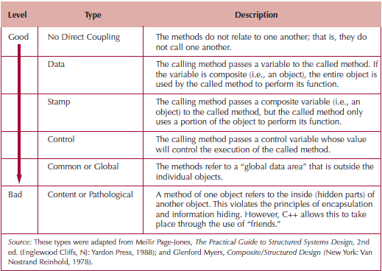
Types of Interaction Coupling

Slide 18
Cohesion
A cohesive class, object or method refers to a single thing
Types
Method cohesion
Does a method perform more than one operation?
Performing more than one operation is more difficult to understand and implement
Class cohesion
Do the attributes and methods represent a single object?
Classes should not mix class roles, domains or objects
Generalization/specialization cohesion
Classes in a hierarchy should show “a-kind-of” relationship, not associations or aggregations

Slide 19
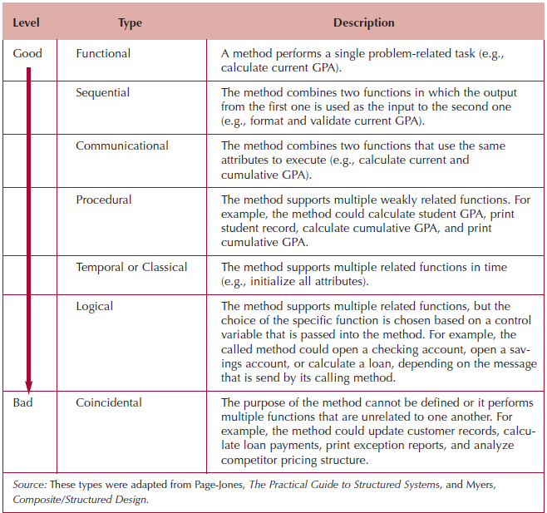
Types of Method Cohesion

Slide 20
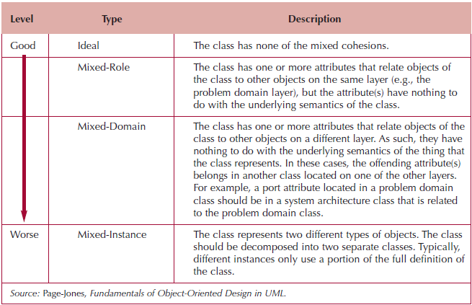
Types of Class Cohesion

Slide 21

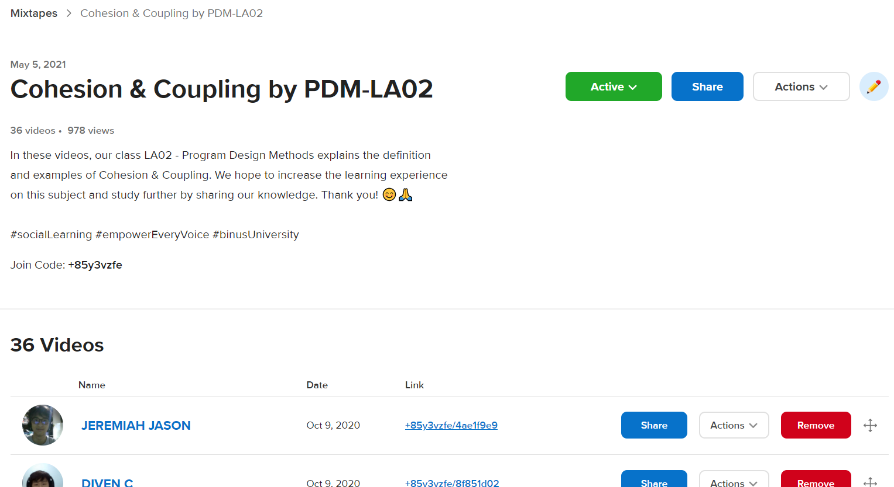
Cohesion & Coupling by PDM-LA02
https://flipgrid.com/+85y3vzfe

Slide 22
Connascence
Classes are so interdependent that a change in one necessitates a change in the other
Good programming practice should:
Minimize overall connascence; however, when combined with encapsulation boundaries, you should:
Minimize across encapsulation boundaries (less interdependence between or among classes)
Maximize within encapsulation boundary (greater interdependence within a class)
A sub-class should never directly access any hidden attribute or method of a super class

Slide 23
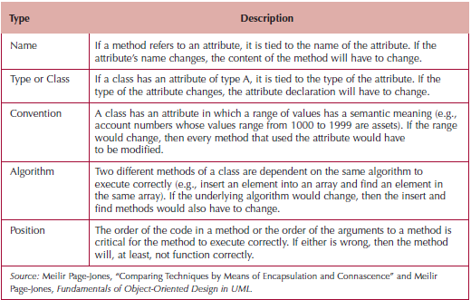
Types of Connascence

Slide 24
Object Design Activities
An extension of analysis & evolution activities
Expand the descriptions of partitions, layers & classes by:
Adding specifications to the current model
Identifying opportunities to reuse classes that already exist
Restructuring the design
Optimize the design
Map the problem domain classes into a programming language

Slide 25
Adding Specifications
Review the current set of analysis models
All classes included are both sufficient and necessary to solve the problem
No missing attributes or methods
Class Student: NIM, Identification ID
No extra or unused attributes or methods
Class Student: NIM, Lecturer Name
No missing or extra classes
Examine the visibility of classes
Private—not visible → generally is for attributes
Public—visible to other classes → generally is for methods
Protected—visible only to members of the same super class
→ generally, is for sub-class / child

Slide 26
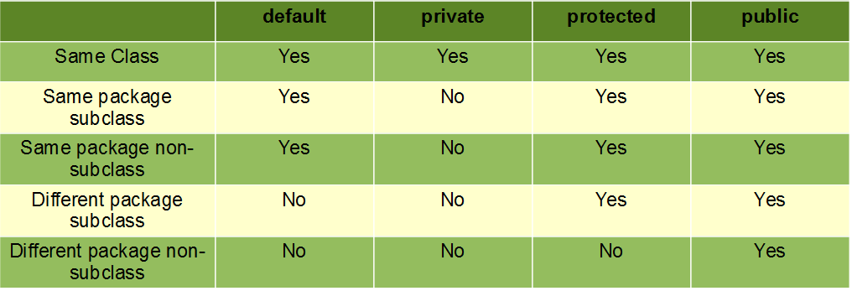
Access Modifiers in Java

Slide 27
Adding Specifications (cont.)
Decide on method signatures:
Name of the method
Parameters or arguments to pass
Type of value(s) to be returned
Define constraints that must be preserved by the objects
Preconditions, post-conditions, & invariants
Decide how to handle constraint violations

Slide 28
Identify Opportunities for Reuse
Design patterns—groupings of classes that help solve a commonly occurring problem
Framework—a set of implemented classes that form the basis of an application
Class libraries—also a set of implemented classes, but more general in nature than a framework
Components—self-contained classes used as plug-ins to provide specific functionality
Choice of approaches depends on the layer

Slide 29
Restructuring the Design
Factoring—separating aspects from a class to simplify the design
Normalization—aids in identifying missing classes
Assure all inheritance relationships support only generalization/specialization semantics

Slide 30
Optimizing the Design
Balance understandability with efficiency
Methods:
Review access paths between objects
Review all attributes of each class
Review direct (number of messages sent by a method) and indirect fan-out (number of messages by methods that are induced by other methods)
Consider execution order of statements in often-used methods
Avoid re-computation by creating derived attributes and triggers
Consider combining classes that form a one-to-one association

Slide 31
Mapping Problem-Domain Classes
Factor out multiple inheritance if using a language that supports only single inheritance
Factor out all inheritance if the language does not support inheritance
Avoid implementing an object-oriented design in non-object languages

Slide 32
Constraints and Contracts
A contract is a set of constraints & guarantees
If the requestor (client) meets the constraints, the responder (server) will guarantee certain behavior
Constraints must therefore be unambiguous
Contracts document message passing between objects
A contract is created for each visible method in a class
PUBLIC
Should contain enough information for the programmer to understand what the method is supposed to do
Constraint types
Precondition—must be true before the method executes
Post-condition—must be true after the method finishes
Invariant—must always be true for all instances of a class

Slide 33
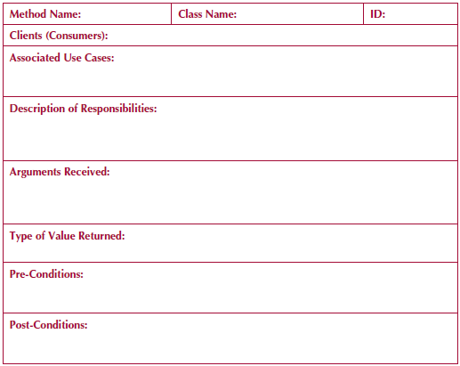
Sample Contract Form

Slide 34
Method Specification
Documentation details for each method
Allows programmers to code each method
Must be explicit and clear
No formal standards exist, but information should include:
General information (e.g., method name, class name, etc.)
Events—anything that triggers a method (e.g., mouse click)
Message passing including values passed into a method and those returned from the method
Algorithm specifications
Other applicable information (e.g., calculations, procedure calls)

Slide 35
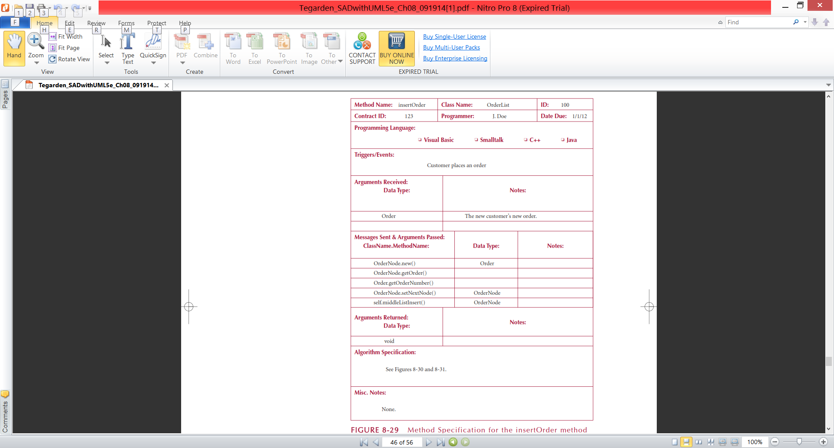
Method Specification Form

Slide 36
Summary
Basic Characteristics of Object Orientation (review)
Class, Polymorphism, and Inheritance
Design Criteria—coupling, cohesion & connascence
Low Coupling 👍
High Cohesion: Method and Class 👍
Avoid Connascence for a better program 👍
Object Design Activities
Review all of design: reuse, complete our class, and remove unnecessary attributes, check the access modifiers
Constraints and Contracts
Build a contract for every method in a class
Method Specification
We can see the relationship between method to every classes
Define the detail of our method: showing the client (receiver of the messages)

Slide 37
References
Denis, Wixom,Tegarden. (2015). Systems Analysis and Design: An Object-Oriented Approach with UML. 5th edition. ISBN: 978-1-118-80467-4, John Wiley & Sons, Inc, Denver (USA)

